Slide 1
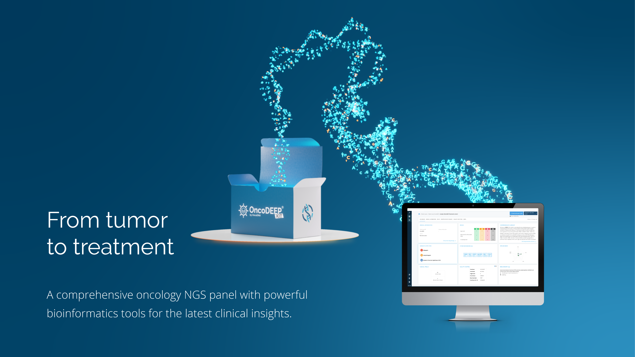



Certified

Slide 2


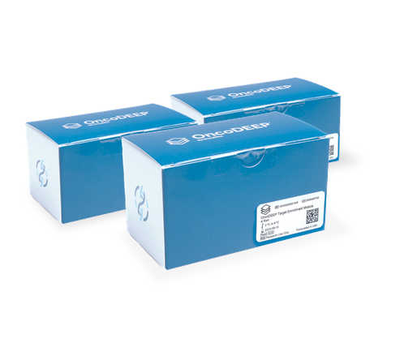
The most innovative oncology kit including a comprehensive NGS panel combined with advanced bioinformatics tools for the latest clinical insights.

Slide 3
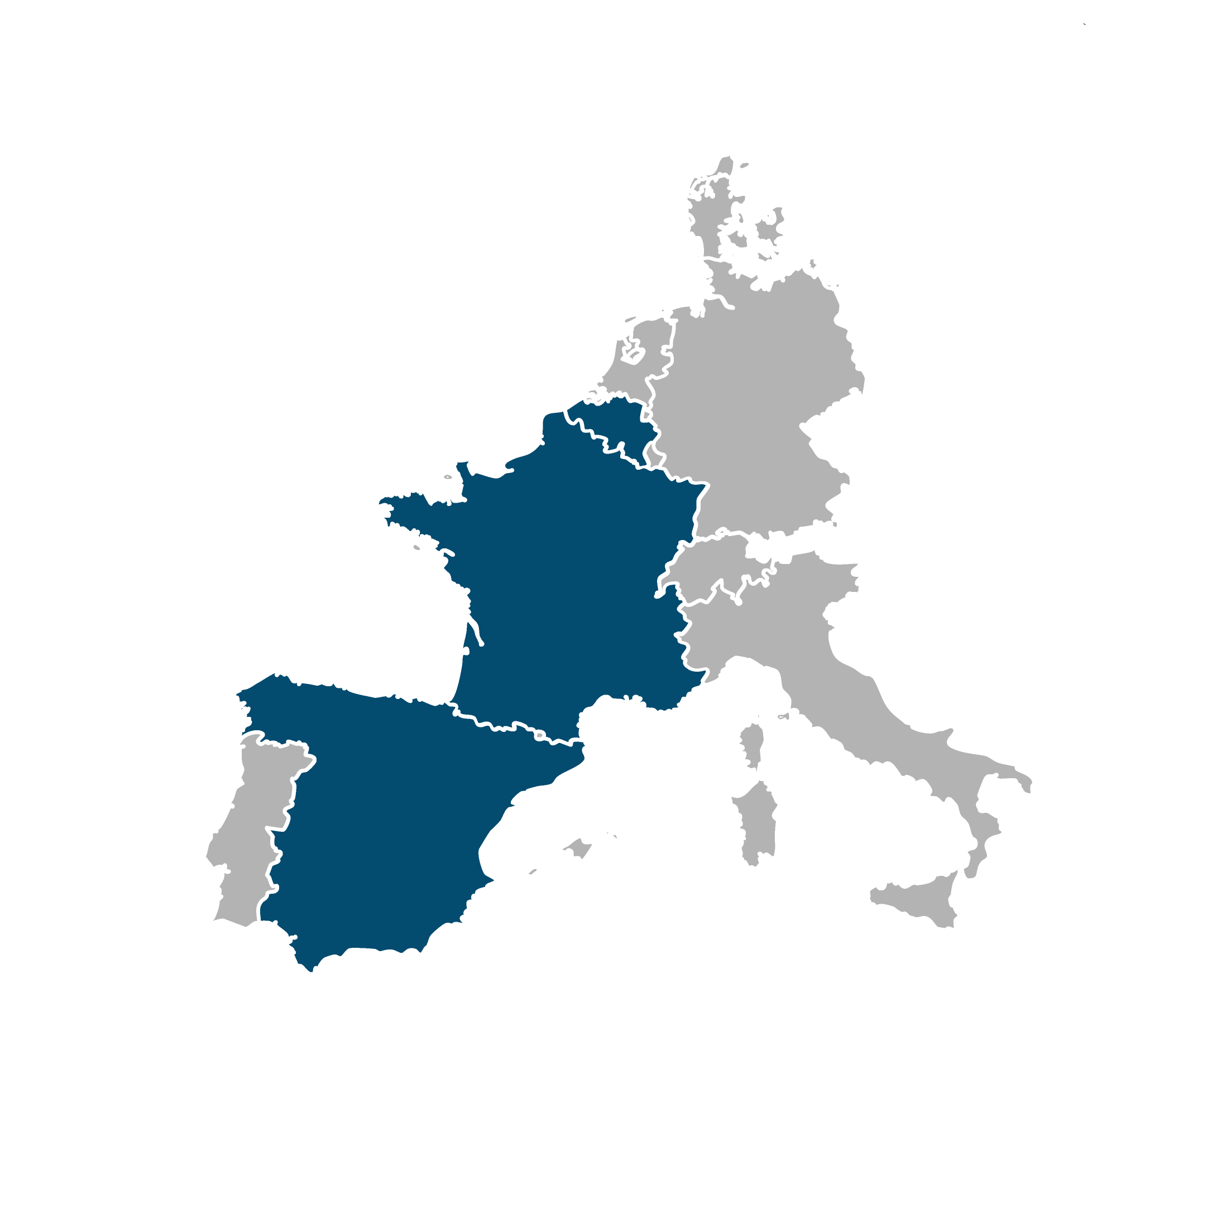
OncoDNA at a glance
OncoDNA Group
Headquarters
Gosselies, Belgium
Grown exponentially since foundation in 2012
Milestone partnerships with leading oncology organizations
Expanded footprint worldwide
IntegraGen
OncoDNA Entity
Evry, France
In 2022
€17M
BioSequence
OncoDNA Entity
Valencia, Spain
in 2022

Slide 4












OncoDNA at a glance
~100
35
6
distributors
active on all continents
collaborators in
countries
4

Slide 5
































Countries and Institutions we received samples* from
*Solid and Liquid
5

Slide 6





OncoDNA commitment to patients
Translational &
clinical research
Academics &
Research Centers
Healthcare
Providers
Treatment selection
& disease monitoring
Patients
Clinical Follow-up Information
Common consideration
across the whole chain
Biopharma
Companies
Drug development
Cancer diagnosis & genomic testing
Pathology Labs
Notes:
Our tumor profiling kits are designed to help laboratories and healthcare centers to adopt comprehensive tissue-based biomarker testing in house. The kits offer a complete workflow solution to screen a tumor tissue for hundreds of biomarkers associated with precision medicines and to analyze the data in full autonomy. Even laboratories with limited bioinformatics capabilities will have all the tools required to advise oncologists in the selection of the most effective and personalized treatments for their cancer patients.

Slide 7








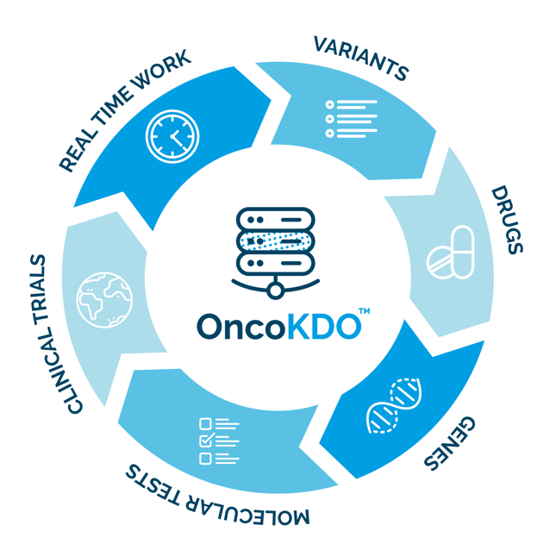
OncoDEEP, initiated for patients by oncology experts
100.000
Molecular tests
More than 10 years of knowledge
in precision medicine
OncoDNA testing solutions
In-house sequencing solution
2024
4,600,000 variants
22,000 genes
1,600 drugs
10,000 clinical trials
100,000 tests performed
2013
Propietary reporting solutions
Propietary reporting solutions
Proprietary Database
Clinical interpretation
Proprietary Database
Clinical interpretation
Proprietary Database
Clinical interpretation
Externalized solutions
In house solutions
Notes:
KEY MESSAGES:
Algorithms, database initiated by experts / medical doctors in oncology (Key differentiator)

Slide 8





OncoDEEP, proven expertise that save lives
Stage III-IV solid tumors in adults, Glioblastoma in children and CUP cancer
AT DIAGNOSIS: advanced or rare cancers where biomarker-matched targeted therapies are available
AT DISEASE PROGRESSION: when the first-line treatment does not work
TURN DEEP INSIGHTS INTO PERSONALIZED
TREATMENT STRATEGIES
Identify the cancer treatment options that match your patient's tumor profile;
Reveal early indication of treatment resistance and spare nonresponders the toxicity of a treatment with no therapeutic benefit;
Consider appropriate oncology clinical trials that are currently recruiting;
Understand why chemotherapy stopped working.
CLINICAL DECISION SUPPORT:
Targeted therapy
Immunotherapy
Chemotherapy
Hormonotherapy
Clinical trials
SAMPLE TYPE : Optimal biopsy shouldn't be older than 6 months. For stage IV cancer, metastatic tissue is preferred
Notes:
KEY MESSAGES:
Algorithms, database initiated by experts / medical doctors in oncology (Key differentiator)

Slide 9





Our knowledge in your LAB
YOUR LAB
Comprehensive
report
DNA extraction
Lib preparation
+
Since 2014
Comprehensive
interpretation
Clinical
interpretation
Variants
identification

Slide 10
OncoDEEP® Kit

Slide 11

Innovative Pan-cancer NGS assay combined with BioIT solutions and oncology expertise
BioIT Pipeline
Knowledge base
+
Reagents
Biological & Clinical interpretation
Tumor molecular profile & therapeutic options
NGS panel
Incorporating Twist Bioscience’s
enrichment and
library preparation solutions
Notes:
OncoDEEP Kit is an integrated solution that combines a pan-cancer NGS assay and data analysis bioinformatics tools for the in-house comprehensive biomarker testing of tumor tissues. With this offering, even laboratories with limited bioinformatics capabilities have the combined ability to profile a large number of cancer biomarkers and assess complex biomarkers in a single test. Combined with OncoDNA bioinformatics software tools, OncoDEEP kit will enable you to identify a broader set of treatment options for patients, while saving on time and cost of outsourcing.
The OncoDEEP Kit integrates reagents and quality control standards to sequence over 600 cancer biomarkers.
Includes OncoDNA’s data analysis and clinical interpretation tools for rapid analysis and reporting of a patient’s tumor molecular profile.

Slide 12
BioIT Pipeline
Bases de Datos
+
Reagents
Interpretación
Biologica & Clinica
Perfil molecular del tumor & the optiones terapéuticas
Panel NGS
Con enriquecimiento de Twist Bioscience’s
y solución de preparación de libreria
Notes:
OncoDEEP Kit is an integrated solution that combines a pan-cancer NGS assay and data analysis bioinformatics tools for the in-house comprehensive biomarker testing of tumor tissues. With this offering, even laboratories with limited bioinformatics capabilities have the combined ability to profile a large number of cancer biomarkers and assess complex biomarkers in a single test. Combined with OncoDNA bioinformatics software tools, OncoDEEP kit will enable you to identify a broader set of treatment options for patients, while saving on time and cost of outsourcing.
The OncoDEEP Kit integrates reagents and quality control standards to sequence over 600 cancer biomarkers.
Includes OncoDNA’s data analysis and clinical interpretation tools for rapid analysis and reporting of a patient’s tumor molecular profile.

Slide 13

Most comprehensive genomic profiling panel
Designed by oncology experts, the OncoDEEP® panel contains the most relevant and complete cancer gene panel. Over time this panel was optimized to include all clinically-relevant oncology targets. The DNA and RNA panels comprise 638 and 22 genes reporting genomic alterations (SNV, insertion, deletion, CNV, fusions, unusual splicing, ...) and complex genomic signature (HRD, MSI and TMB).
HRD assessment for clinical management using
the OncoDEEP® Kit
Article
Notes:
The solution covers a wide range of biomarkers carefully selected for their clinical relevance and offers a unique combination of analyses that proved to maximize the clinical benefits for cancer patients.
The OncoDEEP kit panel targets DNA and RAN across over 600 genes, assessing biomarkers associated with the latest cancer drugs and clinical trials available for solid tumors. It also measures complex genomic signatures, such as homologous recombination deficiency (HRD), microsatellite instability (MSI), tumor mutational burden (TMB), and loss of heterozygozity (LOH).
How do we calculate HRD Score?
We made a specific design to sequence sub-telomeric sequences in addition to the traditional LOH analysis for HRD. We are using HRD scare algorithm to calculate the scare value for LOH and TAI after the mapping on human genome Hg38. Then we are using a proprietary method to define the positivity of the HRD that has been validated by comparing our results in blind with those we got from Myriad Genetics.

Slide 14


OncoDEEP library specifications
Sequence up to
32 samples by kit
Enrichment | Twist Bioscience
Sequencing | Illumina
DNA input quantity (FFPE) | 30 ng
Quality input DNA | DV900 > 49.5%
Mean coverage | 350x
Percentage targets covered | 99%
Uniformity | > 90%
RNA input quantity (FFPE) | 200 ng
Quality input RNA | DV200 > 60%
# reads required for DNA | 16M paired-end reads *
# reads required for RNA | 1M paired-end reads *
Number of samples per flowcell :
NextSeq 500/550 - Mid Output Flowcell : 8 samples
NextSeq 500/550 - High Output Flowcell : 24 samples
NextSeq 2000 - P2 Flowcell : 32 samples
* NextSeq 500/550 2x75bp sequencing
Notes:
The solution covers a wide range of biomarkers carefully selected for their clinical relevance and offers a unique combination of analyses that proved to maximize the clinical benefits for cancer patients.
The OncoDEEP kit panel targets DNA and RAN across over 600 genes, assessing biomarkers associated with the latest cancer drugs and clinical trials available for solid tumors. It also measures complex genomic signatures, such as homologous recombination deficiency (HRD), microsatellite instability (MSI), tumor mutational burden (TMB), and loss of heterozygozity (LOH).
How do we calculate HRD Score?
We made a specific design to sequence sub-telomeric sequences in addition to the traditional LOH analysis for HRD. We are using HRD scare algorithm to calculate the scare value for LOH and TAI after the mapping on human genome Hg38. Then we are using a proprietary method to define the positivity of the HRD that has been validated by comparing our results in blind with those we got from Myriad Genetics.

Slide 15
Sample preparation to clinical insights in just 5 days
3 hours
20 hours
20 hours
Up to 48 hours
Sample
Specimen
Library
preparation
Target
enrichment
Sequencing *
Analysis & interpretation
Extraction*
Upload FASTQ files
Secondary and tertiary analysis via OncoDEEP pipeline
OncoKDM: Personalized therapeutical interpretation
DNA fragmentation, end repair & dA tailing
Ligate Twist universal adapters and purify
PCR amplify using Twist UDI Primers, purify and QC
Prepare libraries for
hybridization
Hybridize capture probes
Bind hybridized targets to
streptavidin beads
Post-capture PCR
amplification, purify and QC
Sequencing on Illumina
NextSeq 500/550, NextSeq
2000 or NovaSeq 6000
Extracted DNA and/or
RNA from FFFPE tumor tissue or unstainned slides
FFPE block
15
* Reagents not included in kit

Slide 16

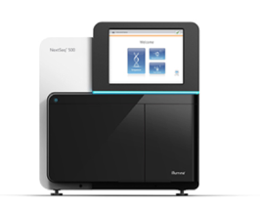
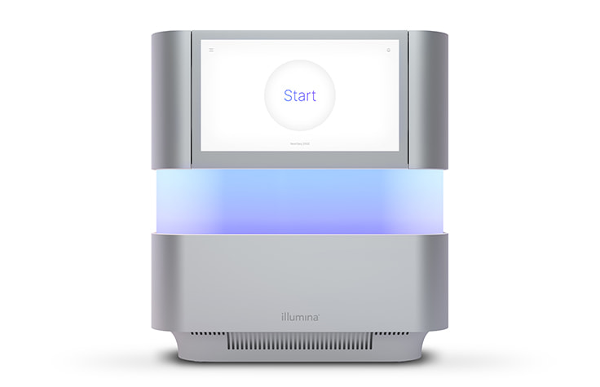
State of the art technology combination for high quality data
0c5273
The OncoDEEP® Kit is based on the library preparation of Twist® technology and Illumina® sequencing platform, validated to support the generation of high-quality data.
Coverage & Uniformity
85
350
NextSeq 500
3.2x10⁷
READ OUR
WHITEPAPER
Coverage (x)
Uniformity (%)
Read number
DNA imput quantity (FFPE sample)
NextSeq 2000
100 ng
30 ng
6 ng

Slide 17
BioIT pipeline &
knowledge base

Slide 18



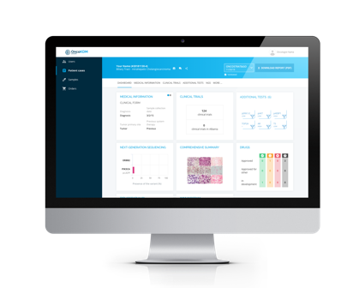




Clinical interpretation of oncogenomic data
thanks to proprietary knowledge base
Sequencing files
Variants identification
and annotation
Data cross-referencing
With knowledge base
Clinical validation
by scientific team
Oncologists
BRAF
PIK3CA
4 500 000 variants
22 000 genes
1400 drugs
9 000 clinical trials
35 000 tests performed
1 000 biomarkers
TP53
BRCA2
FASTQ
INDEL
EGFR
+
Clinical reporting
Cloud transfer
BioIT algorithm
Validation
Pathologist
Mol. biologist

Slide 19

OncoDEEP BioIT pipeline process at a glance
Sequencing files
Transfer
Clinical validation
by scientific team
Annotation / Classification
Data cross-referencing
with OncoKDO proprietary
knowledge base
Alignment
Variants calling
Bias cleaning
FASTQ
QC check
HRD
MSI
TMB
CNV
LOH
Alpha-list (Hot spots list)
4,500,000 variants
22,000 genes
1,400 drugs
9,000 clinical trials
35,000 tests performed

Slide 20




OncoKDO, advanced oncogenomic database
4,500,000
Proprietary input
Clinical data from
25,000 patients
1,400
External sources
> 15 public databases
Clinical literature
Since 2013
Manual, daily
data curation
by our scientists
9,000
22,000
Accurate Data
Dynamic
Constantly growing
35,000

Slide 21
Clinical interpretation

Slide 22
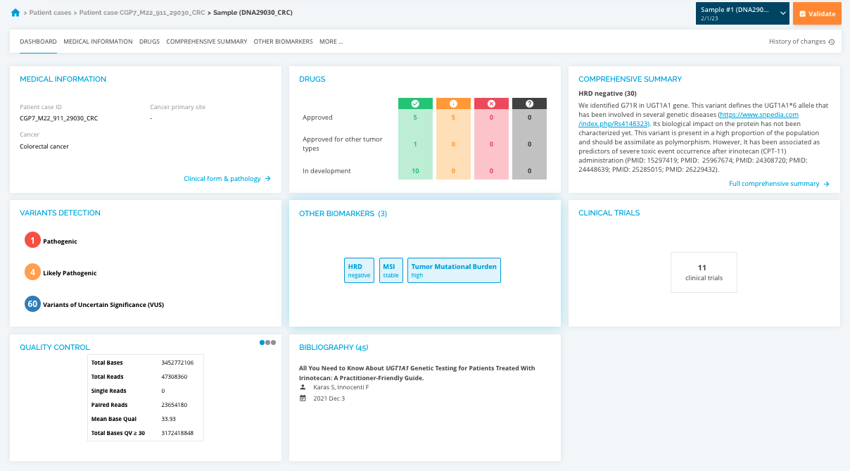

Tumor molecular profiling and treatment decision
CLINICAL INTERPRETATION
Clinical information
Detected variants classified based on ACMG/AMP
guidelines / Hotspots / Incidental findings
Genomics signatures (TMB, HRD, MSI)
and related clinical impact
Treatments recommendation
Clinical Trials selection
Bibliography
Clear comprehensive summary
EDIT AND SHARE YOR REPORT

Slide 23
Dedicated Support

Slide 24



We support labs all along their projects
Field application team
Wetlab implementation
BioIT Team
Pipeline optimization
Your lab
Scientific team
Scientific Data validation
Medical team
Clinical interpretation

Slide 25

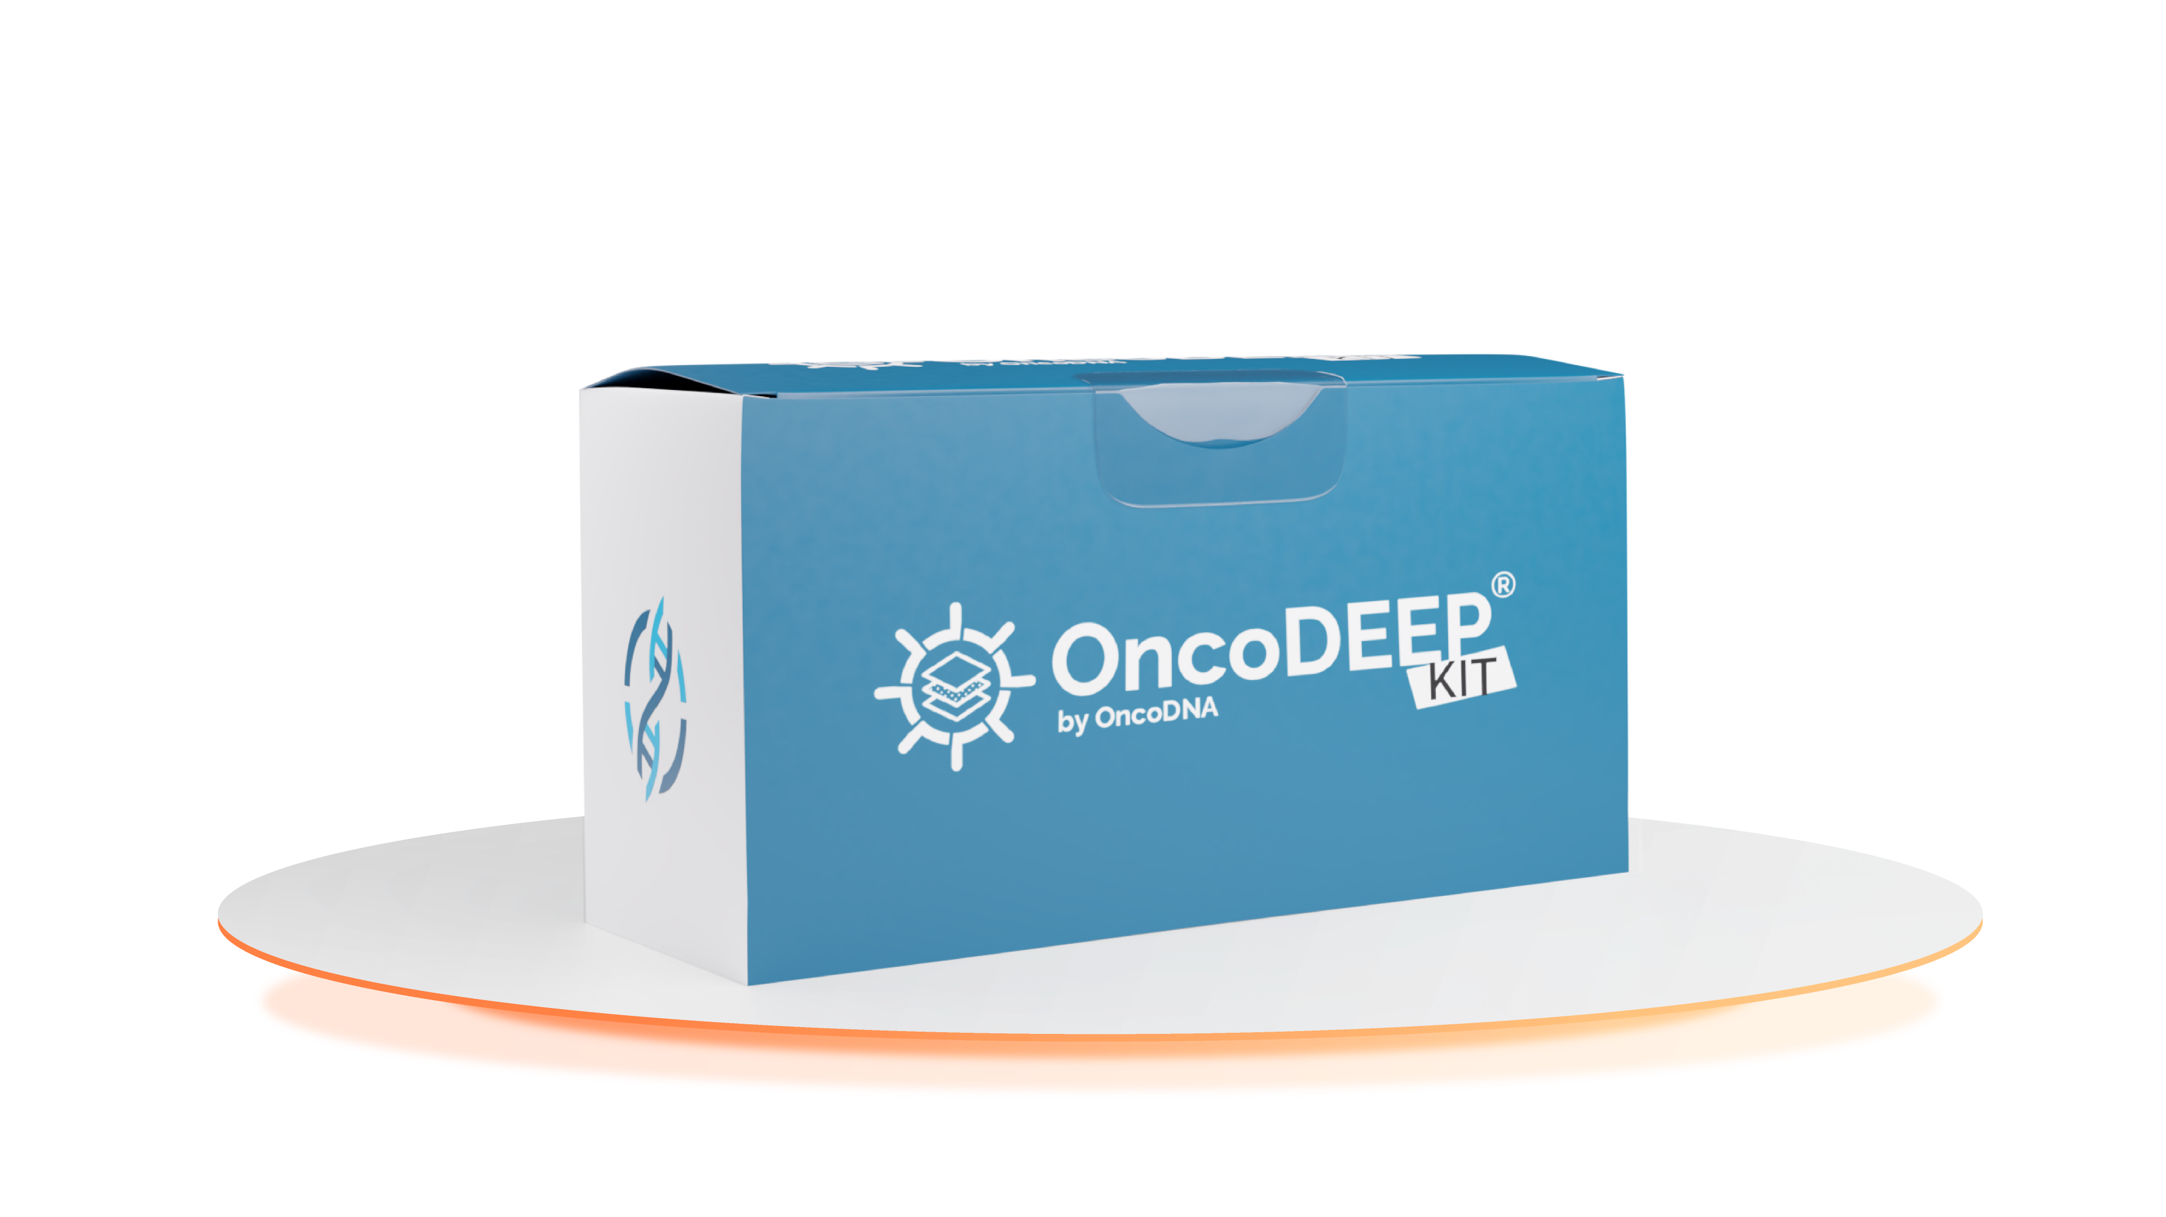
Your Sales contact:
Marc Elias
m.elias@oncodna.com
Visit our website www.oncodna.com

